Slide 1
Foundations of Single‑Cell Transcriptomics
Ardo Sanjaya, MD., PhD

Slide 2
Speaker Introduction
Ardo Sanjaya, PhD
Current Role:
Lecturer in the Faculty of Medicine at Maranatha Christian University, Bandung
Head of the Biomedical Research Laboratory
Main Research Topic:
Transcriptomics (Bulk & Single-Cell RNA-Seq): Breast and Nasopharyngeal Cancer
Cancer Biology
Medical Education & Student Well-being

Slide 3
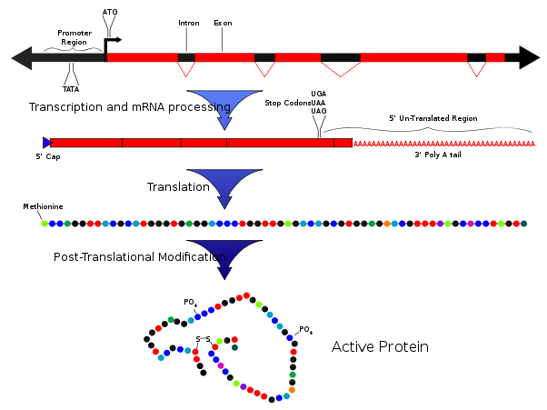
The Central Dogma
A simplification, but Important

Slide 4

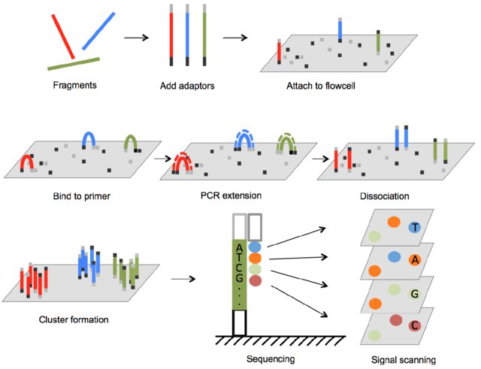
Sequencing-by-synthesis (Illumina)

Slide 5
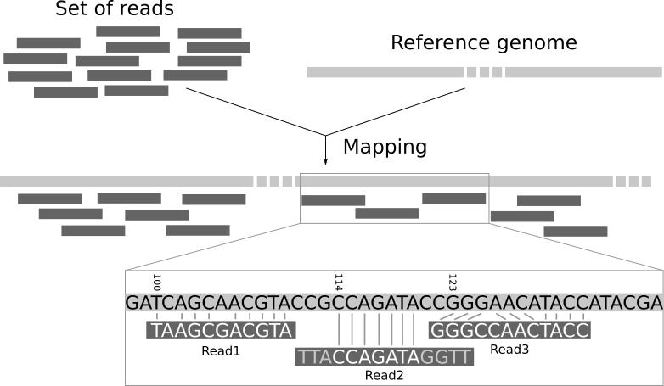
Sequencing-by-synthesis resulted in “reads” not true quantification of the genes

Slide 6
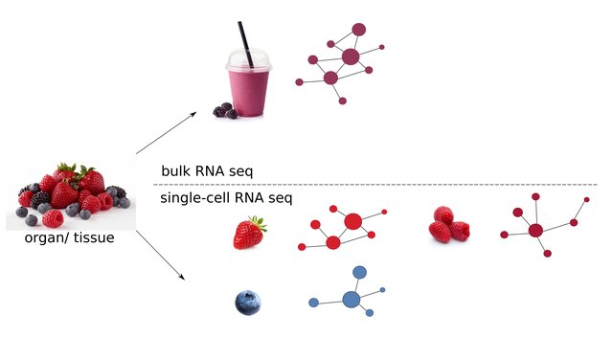
Why single‑cell transcriptomics?
Benchmarking scRNA-seq imputation tools with respect to network inference highlights deficits in performance at high levels of sparsity. Lisa Maria Steinheuer, Sebastian Canzler, Jörg Hackermüller bioRxiv 2021.04.02.438193; doi: https://doi.org/10.1101/2021.04.02.438193
Notes:
Begin by reminding participants that bulk RNA‑seq profiles gene expression across thousands to millions of cells. While this has generated insights into gene regulation, it averages out variation and hides cell‑specific behaviours. Many biological processes—development, immune responses, tumor evolution—are driven by heterogeneity. Single‑cell RNA‑seq (scRNA‑seq) addresses this by measuring the transcriptome of individual cells, enabling discovery of rare cell types, intermediate states and lineage trajectories

Slide 7
The usefulness of Single-Cell Transcriptomics
Resolves heterogeneity
Distinguishes different cell types/states within complex tissues.
Identifies rare populations (e.g., stem cells, tumor-infiltrating immune cells).
Maps developmental trajectories
Reveals how cells differentiate and transition across states.
Pseudotime and lineage inference give temporal insights.
Improves disease understanding
Dissects tumor microenvironments, immune landscapes, neuronal diversity.
Links cell states to pathology (cancer, autoimmunity, neurodegeneration).
Enables personalized medicine
Profiles patient samples at cellular resolution.
Identifies biomarkers and druggable targets at single-cell resolution.

Slide 8
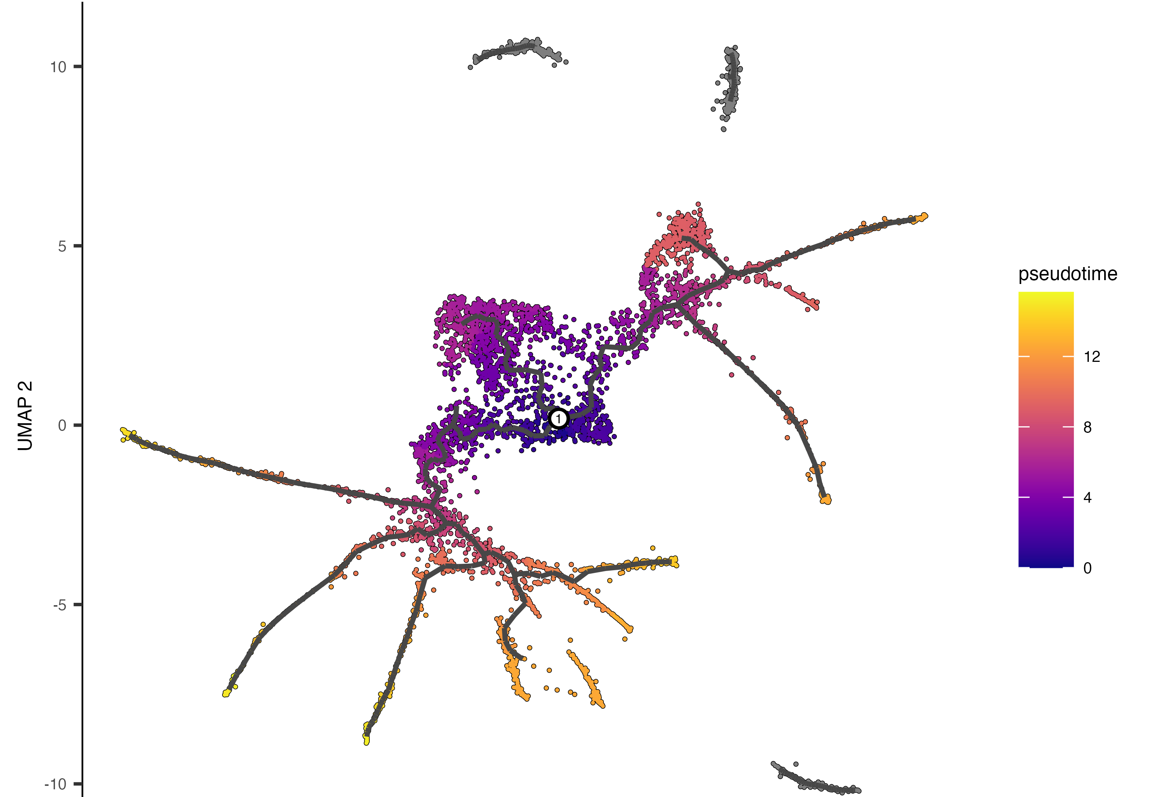
Developmental Trajectories (Pseudotime Analysis)
Trapnell, C., Cacchiarelli, D., Grimsby, J. et al. The dynamics and regulators of cell fate decisions are revealed by pseudotemporal ordering of single cells. Nat Biotechnol 32, 381–386 (2014). https://doi.org/10.1038/nbt.2859

Slide 9
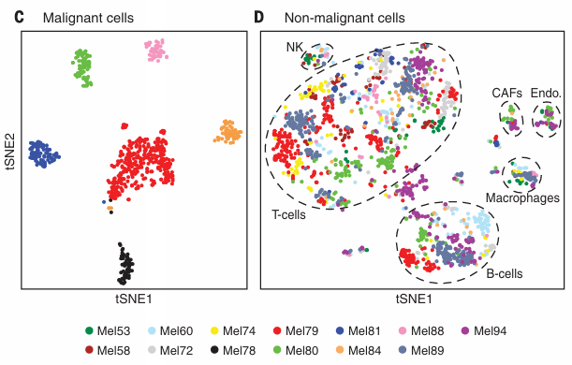
Resolving Heterogeneity
Itay Tirosh et al., Dissecting the multicellular ecosystem of metastatic melanoma by single-cell RNA-seq. Science 352, 189 -196 (2016). DOI: 10.1126/science.aad0501

Slide 10
Overview of scRNA‑seq technologies
10x Chromium (10x Genomics)
Uses microfluidic droplets to capture single cells + barcoded gel beads.
Extremely high throughput (10,000–100,000 cells).
Smart-seq3
Captures full-length transcripts (not just ends).
Higher sensitivity per cell (detects lowly expressed genes).
Throughput is low (hundreds of cells, not thousands).
Notes:
Introduce the taxonomy of scRNA‑seq protocols. Full‑length methods (e.g., Smart‑seq2, SUPeR‑seq, MATQ‑seq) capture entire transcripts and enable isoform analysis. They lack UMIs and have higher per‑cell cost but detect more genes. In contrast, 3′/5′ counting protocols (Drop‑seq, CEL‑seq2, 10X Chromium) capture only transcript ends but use UMIs and offer higher throughput at lower cost; they suit large‑scale profiling and discovery of rare populations. Describe how droplet microfluidics (e.g., 10X Chromium) can process thousands of cells simultaneously.

Slide 11
Single‑cell isolation methods
Limiting dilution / serial dilution
Fluorescence-Activated Cell Sorting (FACS)
Magnetic sorting / MACS
Laser Capture Microdissection (LCM)
Microfluidics (droplet / microwell / chips)
Combinatorial Indexing / Split-Pool Barcoding
Notes:
Explain common ways to isolate single cells: limiting dilution (inefficient), micromanipulation for low‑cell numbers, FACS for high‑throughput sorting based on fluorescent markers, LCM for dissecting cells from tissues, and microfluidics for precise, low‑cost cell capture. Stress that each method balances throughput, purity and technical complexity

Slide 12
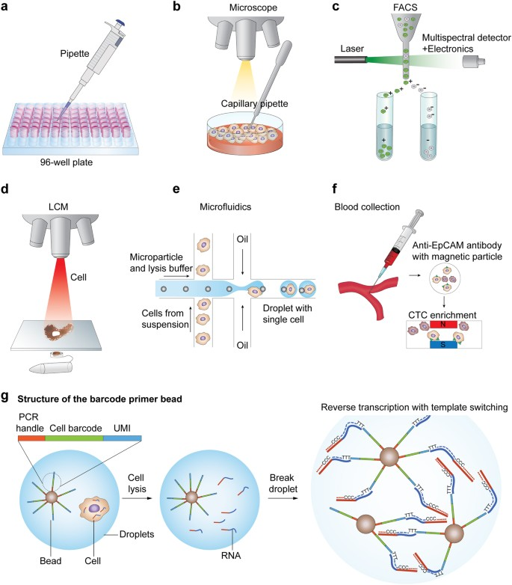

Slide 13
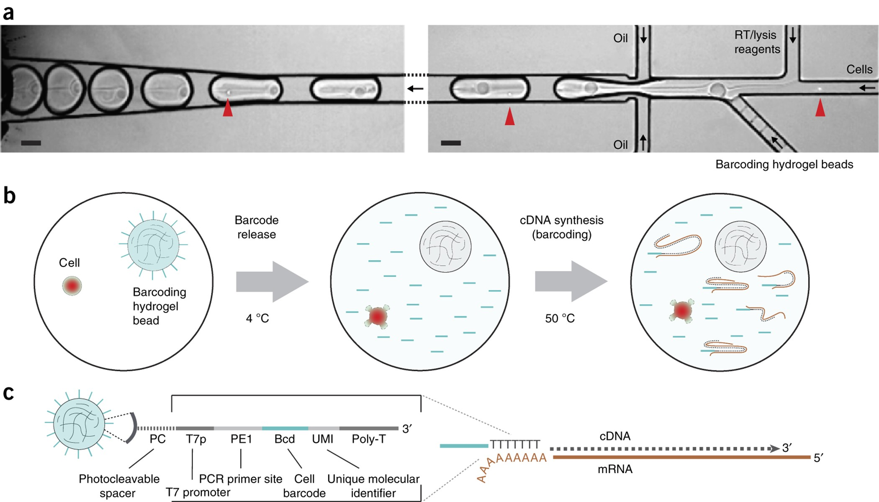

Slide 14
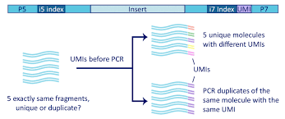
Unique molecular identifiers (UMIs) & Barcodes
UMIs: random nucleotide barcodes incorporated during reverse transcription. Useful for Removing Duplicates
Notes:
Define UMIs: random nucleotide barcodes incorporated during reverse transcription. They tag each cDNA molecule, allowing PCR duplicates to be removed and improving quantification accuracy. Many droplet‑based methods incorporate cell barcodes to multiplex thousands of cells.

Slide 15
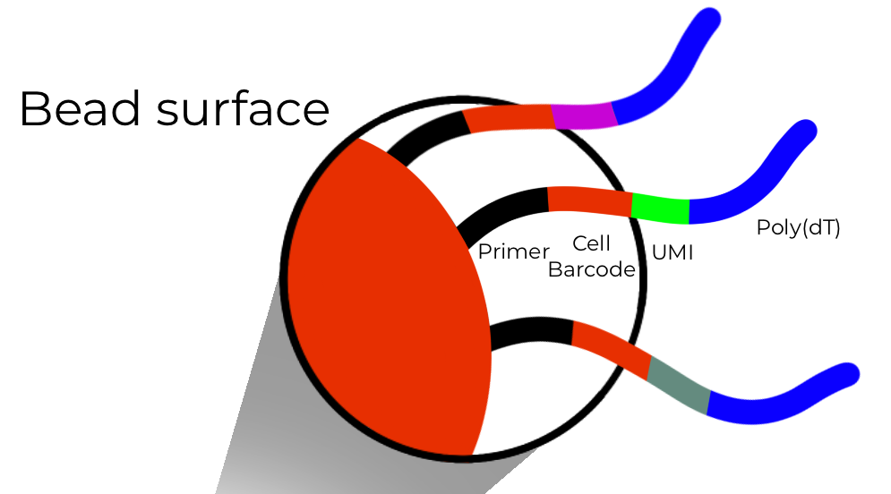
Barcodes
Used to mark individual cells

Slide 16
Experimental design considerations
Planning is Critical
What are the objectives?
How many are the replicates
How many cells are being sequenced?
How many reads?
Account for batch effects
Notes:
Emphasize that planning is critical. Determine biological objectives (e.g. cell‑type classification vs. differential expression), which dictates the number of cells and sequencing depth. Unbiased identification of distinct cell types can be achieved with ~10,000–50,000 reads per cell. To detect subtle transcriptional differences or low‑abundance transcripts, deeper sequencing (~0.5–1 million reads per cell) is recommended. Encourage replicates (biological and technical), proper controls and randomization to minimize batch effects.

Slide 17
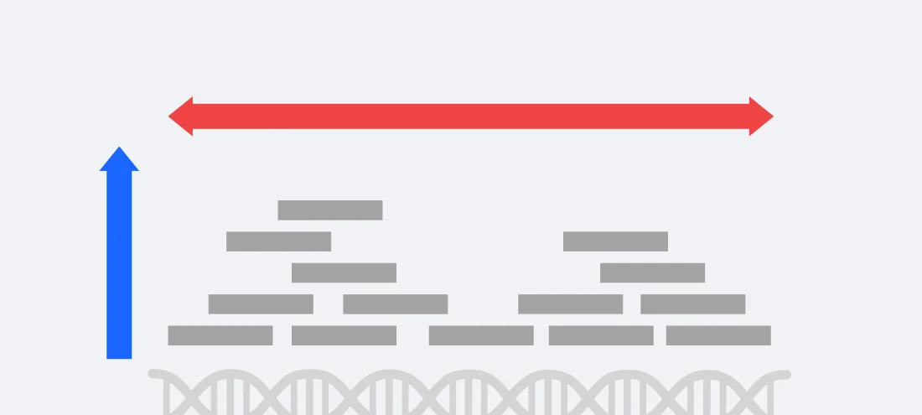
The Importance of Sequencing Depths

Slide 18
RNA-Seq Sequencing Depths vs Single Cell Sequencing Depths
RNA-Seq
Low ~ 10 million reads
Medium ~ 30 million reads
High > 50 million reads
Single-Cell
Standard: 10,000 – 50,000 reads (per cell)
Smart-Seq2: up to 1 million reads (per cell)
Read: ~ 50 – 100 bp
10 mil reads ~ 1 billion nucleotide
30 mil reads ~ 3 billion nucleotide
Human transcriptome ~ 100 million nucleotide

Slide 19
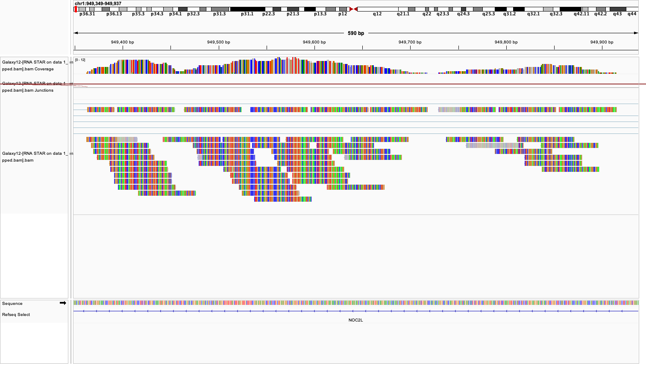
Read Alignments and Quantification

Slide 20
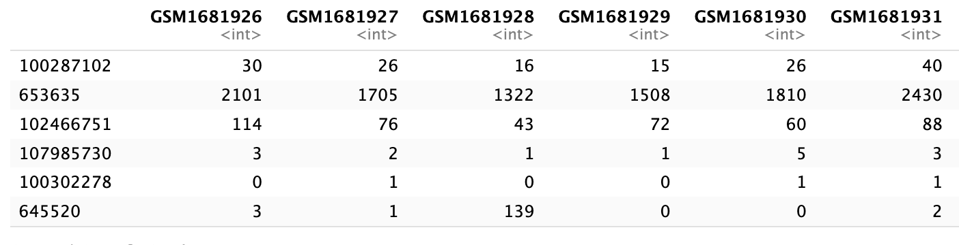
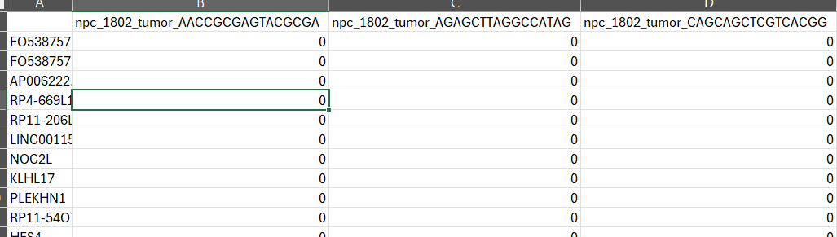
Results RNA-Seq vs Single Cell RNA-Seq

Slide 21
Data Management and Analysis
scRNA-seq generates large, complex datasets (FASTQ, count matrices, Seurat objects
Key practices:
Organize files & metadata (sample IDs, batch info, QC metrics).
Use structured formats: .csv for metadata, .rds (Seurat), .h5ad (AnnData).
Backup strategy: local + institutional + cloud.
Document all filtering/QC thresholds.

Slide 22
Typical Workflow: From Sequencing to Count Matrix
Sequencing Output
Format: FASTQ (raw reads)
Contains nucleotide sequences + quality scores.
Preprocessing & Alignment
Step: Demultiplexing (assign reads to samples, if multiplexed).
Tools: Illumina bcl2fastq, Cell Ranger mkfastq.
Output: FASTQ per sample/library.
Barcode & UMI Processing
Extract cell barcodes & UMIs from Read 1.
Correct sequencing errors in barcodes.
Collapse UMIs to avoid PCR duplicates.
Transcript Quantification
Assign reads to genes using reference annotation (GTF).
Drop reads without valid cell barcodes or UMIs.
Downstream Analysis Input
These count matrices are then imported into:
Seurat (R) → Read10X() or ReadMtx()
Scanpy (Python) → .h5ad format

Slide 23
Core Analyses (Essential Steps)
QC & Filtering → remove low-quality cells, doublets, high mito %.
Normalization & Scaling → account for sequencing depth.
Dimensionality Reduction → PCA → UMAP/t-SNE for visualization.
Clustering → identify putative cell populations.
Marker Gene Identification → FindMarkers (Seurat) or DE tests.

Slide 24
Advanced Analyses (Optional)
Cell Type Annotation → manual (markers), automated (SingleR, Azimuth).
Trajectory Inference & Pseudotime → Monocle, Slingshot.
Cell–Cell Communication → CellChat, NicheNet.
Integration → across batches, modalities (CITE-seq, ATAC-seq).
Gene Set/Pathway Analysis → GSEA, AddModuleScore, enrichment tools.

Slide 25
Technical challenges and limitations
scRNA‑seq data are sparse and noisy due to low mRNA capture efficiency
Dropouts are common where expressed genes are not detected
Low-quality cells (dead or broken) can contaminate datasets
Batch effects are well documented, especially across protocols or operators
Notes:
Address limitations: scRNA‑seq data are sparse and noisy due to low mRNA capture efficiency (often 10–40 %) and dropouts where expressed genes are not detected. Low‑quality cells (e.g., broken or dead cells) and doublets can contaminate datasets. There is also bias in transcript coverage (3′ bias in droplet methods) and batch effects from different protocols or operators. Highlight that proper quality control and normalization are crucial to mitigate these issues.

Slide 26
Note the many zeros

Slide 27
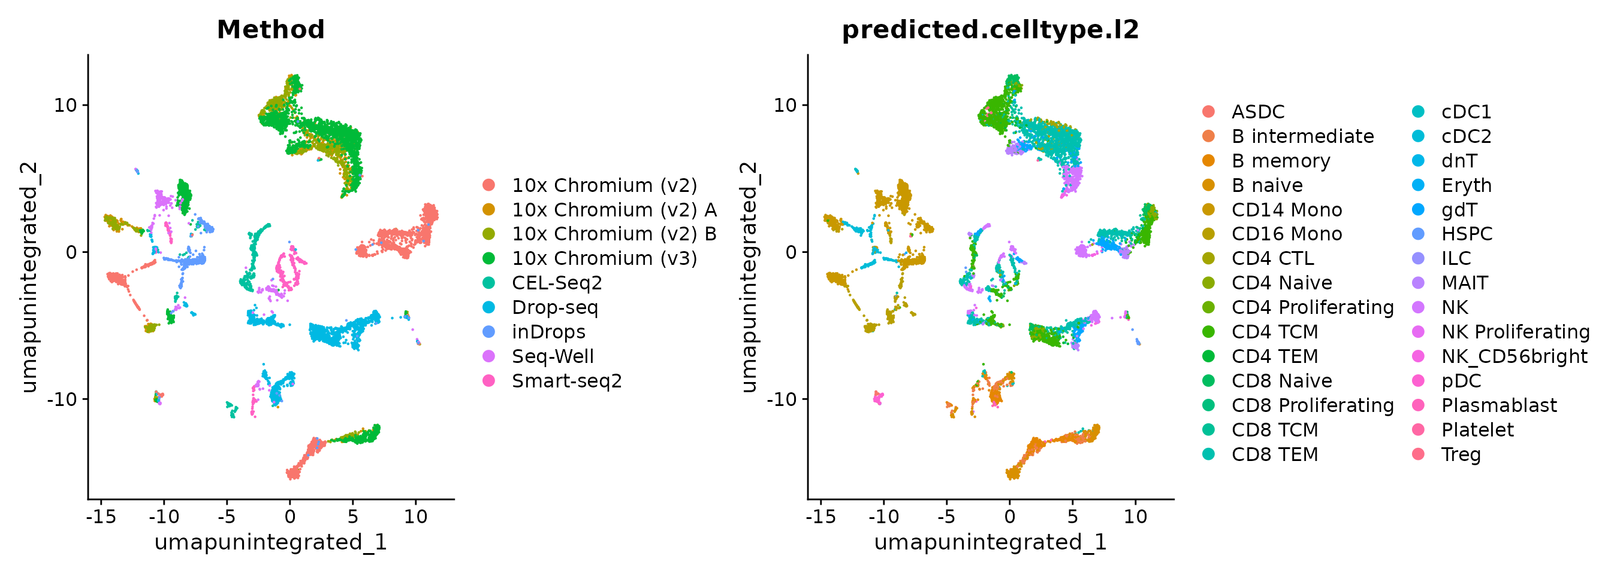
Batch Effects in Real World Example

Slide 28
References
Hwang, B., Lee, J.H. & Bang, D. Single-cell RNA sequencing technologies and bioinformatics pipelines. Exp Mol Med 50, 1–14 (2018). https://doi.org/10.1038/s12276-018-0071-8
Satija Lab. (2024). Seurat v5 tutorials and documentation. https://satijalab.org/seurat/
Luecken, M. D., & Theis, F. J. (2019). Current best practices in single-cell RNA-seq analysis: a tutorial. Molecular Systems Biology, 15(6), e8746. https://doi.org/10.15252/msb.20188746

Slide 29
THANK YOU
Notes:
Conclude by mentioning advances like CITE‑seq (combining scRNA‑seq with protein measurements), multi‑omic integration (scATAC‑seq) and spatial transcriptomics. Point out that full‑length protocols capturing both polyA⁺ and polyA⁻ RNAs (e.g., MATQ‑seq) allow researchers to explore long noncoding RNAs and circular RNAs as potential biomarkers.

